Slide 1

Tower Defense Game C++ & GLUT
By Martyn van Dijke
Computation II

Slide 2
Second year Electrical Engineering student
Linux hobbyist
Love programming
Program experience with:
Python (2.7)
SQL
HTML
C ( Computation I )
Arduino language
About me

Slide 3
Contents of the Presentation
Game overview
Additional features that have been implemented
Improvements that can be made
Conclusion
Demonstration of the game
Questions
Contents

Slide 4
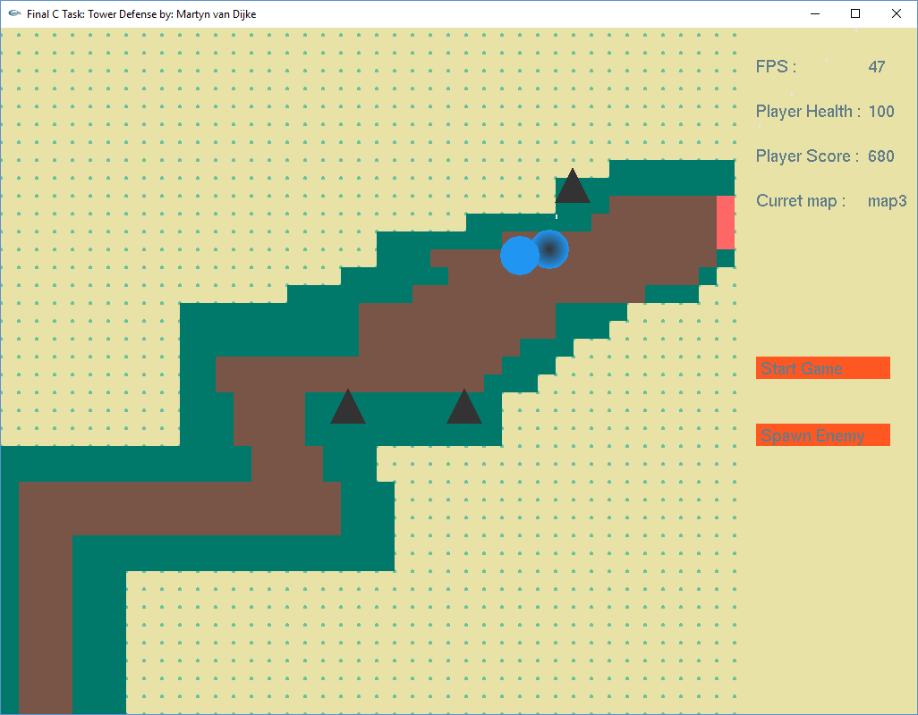
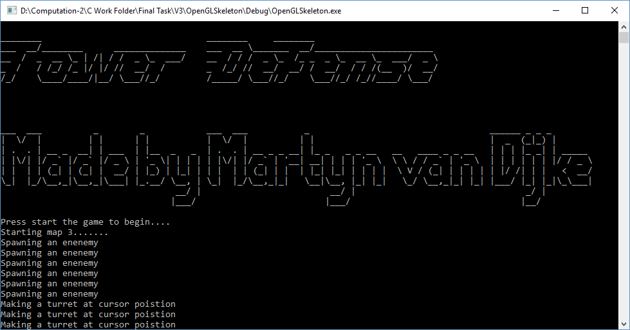
Basic
Turret aiming
Enemy movement
Map data where to build & walk
GUI
Debug & control
Overview of the game

Slide 5
Number
Statictics

Slide 6
Extra features that have been implemented
Sound effects
Multiple maps
Button’s
Mouse input
Keyboard input
GLUT window input (right mouse click)
Frame per second calculation
Additional features

Slide 7
Improvements that can be made to the game
Aim algorithm
More predictive aiming in y direction
Walk algorithm
A* walk algorithm
Improvements to be made

Slide 8

Conclusion
Fun to program in C++
C++ is great programming langue, learned a lot from it
C++ is very extensible and fast
C++ & GLUT can be cumbersome some times
Conclude

Slide 9
Demo
Map
Demo

Slide 10

Are there any questions ?
Questions

Slide 11
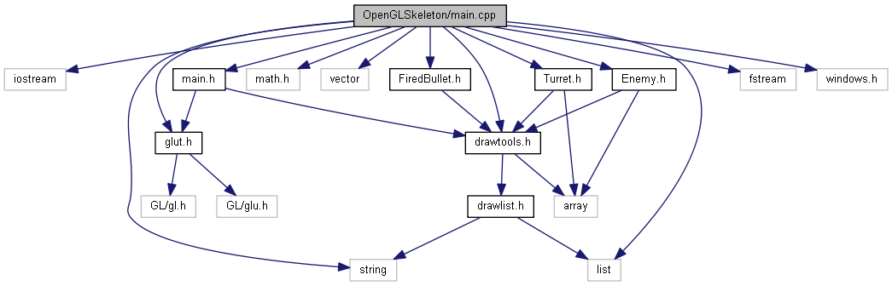
Important library includes
Vector use instead of (linked) list
Mat library for calculating (mostly circles and intersection points)
Fstream and iostream for file (map) access
Windows for waiting
Library includes

Slide 12
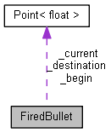
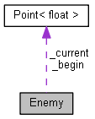
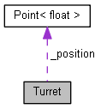
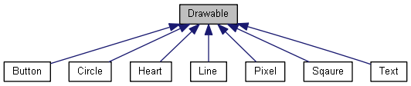
Classes
FiredBullet
Enemy
Turret
Drawable:
Button
Circle
Line
Square
Text
Features

Slide 13
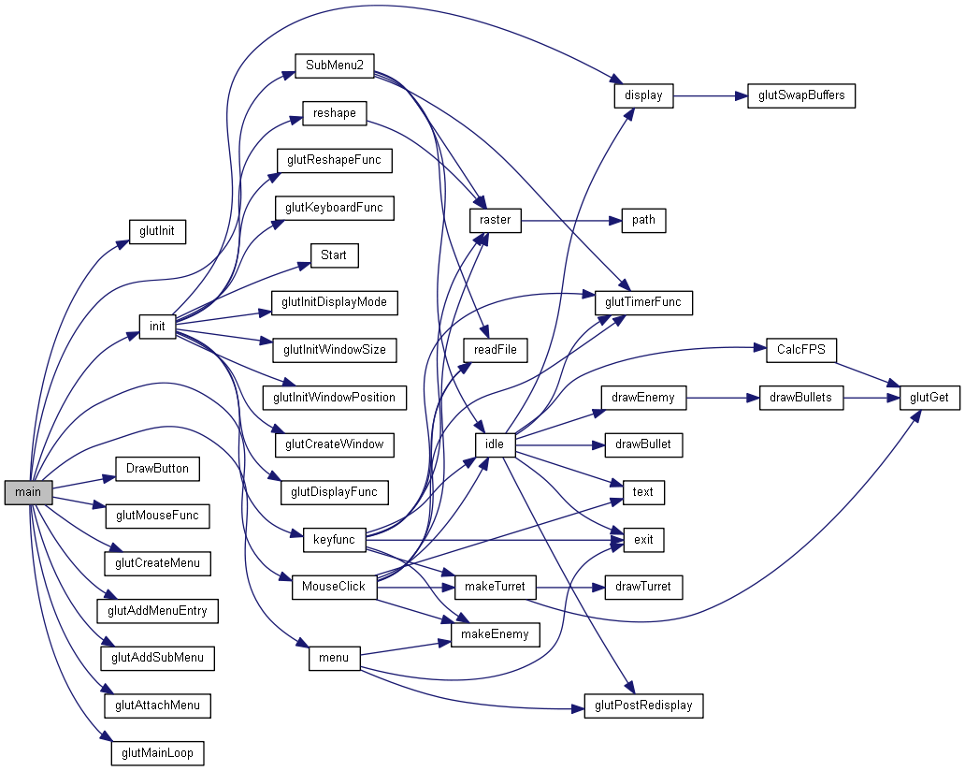
Overview of the
Main code :
Overview Code I Main
Notes:
In order to explain this mess of networks a look is made in the init function and the keyboard function along with the nececarry stops into classes etc

Slide 14
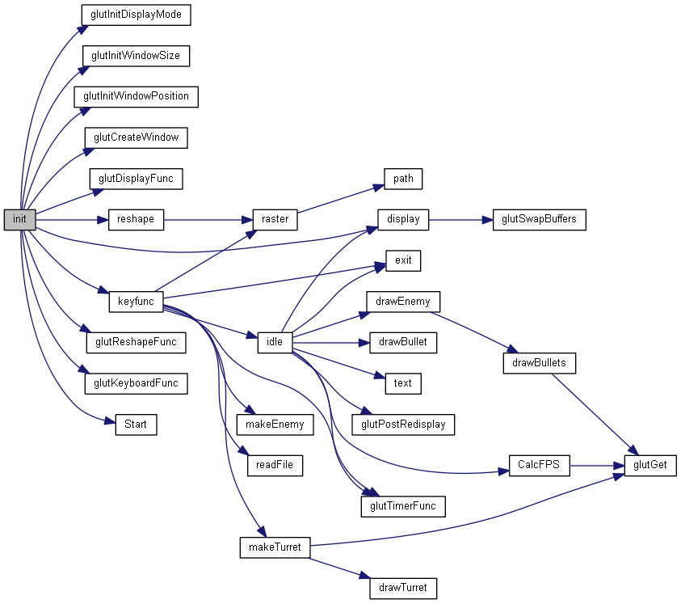
Init()

Slide 15
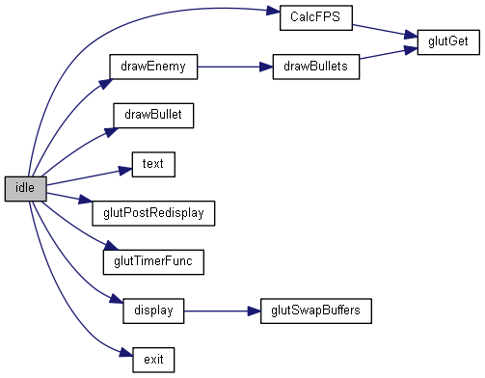
Idle()
Overview || Important functions

Slide 16
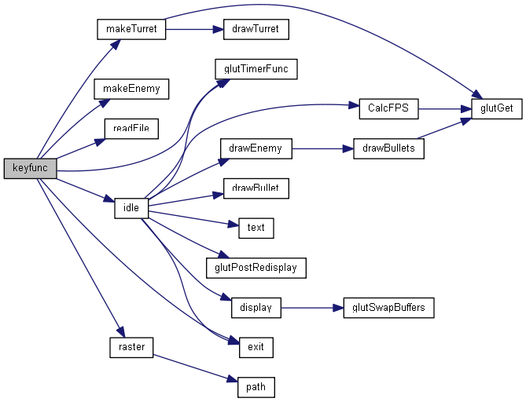
Keyfunc()

Slide 17
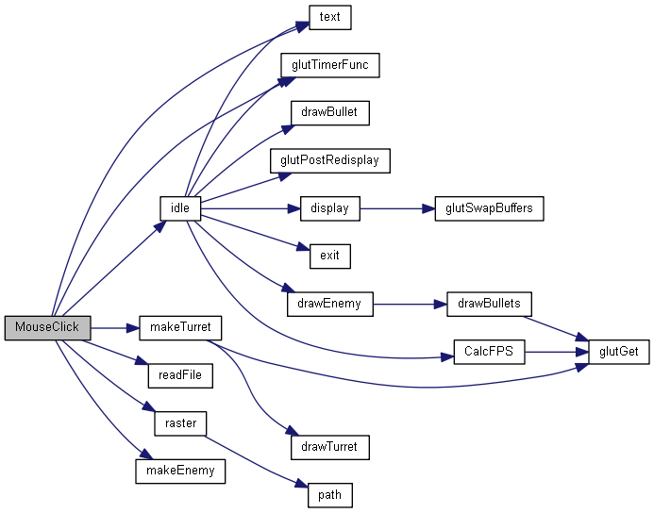
MouseClick()

